Slide 1
Database design
Lecture 12

Slide 2
IP development model
The process of creating an IP is called system development
The technical approach to IP development is based on an IP lifecycle model
The life cycle of an IP is the history of the creation of
The life cycle of an IP consists of a number of stages
Two main models of the IP life cycle:
Iterative
Сascading

Slide 3
Stages of the IP life cycle
Planning
Initial assessment
Study of feasibility
Analysis of user requirements
Evaluation of existing systems
Choosing a system architecture
Specification of requirements
System architecture development
DB project development
Application project development
Coding and debugging
Testing
Installation and Configuration
Service
Evaluation
Expansion
Analysis
Project development
Project implementation
Escort

Slide 4
Iterative life cycle model
Overlap in time
Planning
Analysis
Project development
Project implementation
Escort
Time
Schedule of work density

Slide 5
Cascade life cycle model
The previous stage is completed completely before the start of the next stage
Planning
Analysis
Project development
Project implementation
Escort
Time
Schedule of work density

Slide 6
Software development methods
Many software development methodologies have been developed on the main life cycle models
Rational Unified Process (RUP)
V- Model
Spiral model Test-driven development (TDD) (development through testing)
Lean Software
Development:
Extreme programming;
Scrum
Kanban

Slide 7
Database lifecycle
The process of creating a database takes place as part of the process of creating an IP
The database has its own life cycle
Planning and initial evaluation of the DB construction strategy and its structural implementation
Identification and analysis of business processes and information structures in the subject area
Database and application project development
Installing a DBMS and creating a DB
Coding and debugging applications
Testing
Service
Evaluation
Expansion
Planning
Analysis
Project development
Project implementation
Escort

Slide 8
Database design
Database design is the process of creating a database project
The design process ends with the creation of the project
The basis of a relational database project is a database schema containing a set of interrelated relationships in which all attributes, their types and integrity constraints are defined, primary and secondary keys are set, indexes are defined.
The database project also contains a diagram of the physical placement of the database components, a description of the specification of the implemented software components (queries or views, CP, T, etc.), etc.

Slide 9
Database design
The main problem that is solved when designing a database is the elimination of data redundancy, which leads to the complication of data processing algorithms and database anomalies that destroy data integrity.
There is a distinction between non-redundant and redundant duplication. Non-redundant is allowed, but redundant can lead to anomalies.
When trying to change the state of the database for some relationship schemes, undesirable effects may occur, which are called anomalies.
Anomalies are a contradiction between the subject area and the data contained in the database or the complexity of data processing.
Anomalies arise due to the fact that our knowledge of the subject area is, for some reason, incorrectly expressed in the database schema or in conflict with it.

Slide 10
Database anomalies
Classic DATABASE anomalies:
anomalies of addition
Manifest itself in the inability to add the required tuple to the relation (when adding, the integrity constraint supported by the DBMS is violated), for example, for the relation, when adding information about a subject, it is necessary to add information about the group
R(group, specialty, subject, lc, pz, teacher)
The reason for the anomaly is the storage of heterogeneous information in one respect (both about the subject, and about the group, and about the specialty).
deletion anomalies
Manifest when useful information is "lost" when deleting a tuple, for example, in relation to
deleting a group will require deleting all students
R(group, headman, student, academic performance)
modification anomalies
Manifest when, when changing data, you can get ambiguous information about the object, for example, when replacing the headman in relation to
we will have to make multiple substitutions, as a result, one group may have different elders…
R(group, headman, student, academic performance)

Slide 11
Database design
The DB design process is a sequence of transitions from an informal description of the information structure of the domain to a formalized description of the objects of the domain in terms of a certain model
In the design process , the following stages are distinguished
The source material for the database design stage is the business model of the domain obtained after the analysis stage, containing a description of the activities of participants in the information process and the information attributes of this activity (input and output documents), and a specification of system requirements,where the information components of the system are described, the types of users, their functions in the system, the requirements for scaling and performance of the system when executing requests, etc., etc.
Conceptual design
Data logical design
Physical design

Slide 12
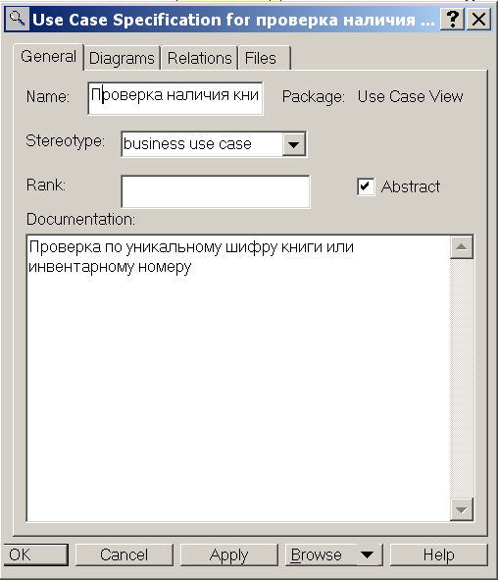
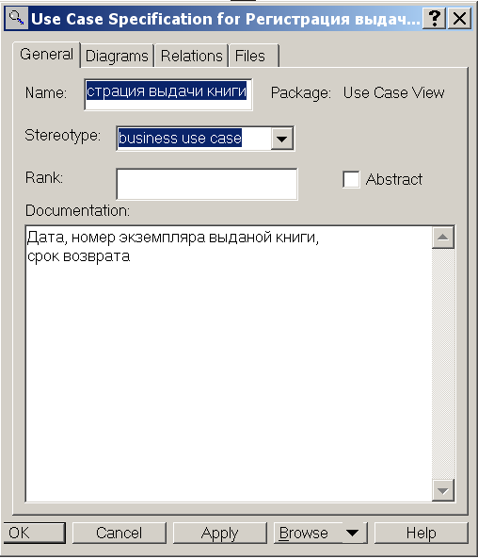
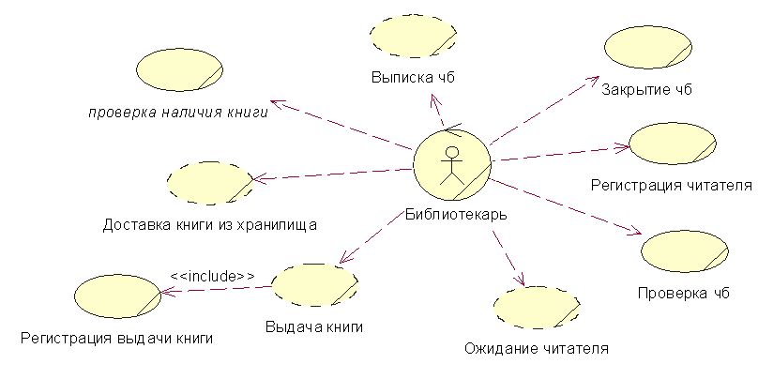
Database design
Example of a description of a domain business model in UML (business function diagram)

Slide 13
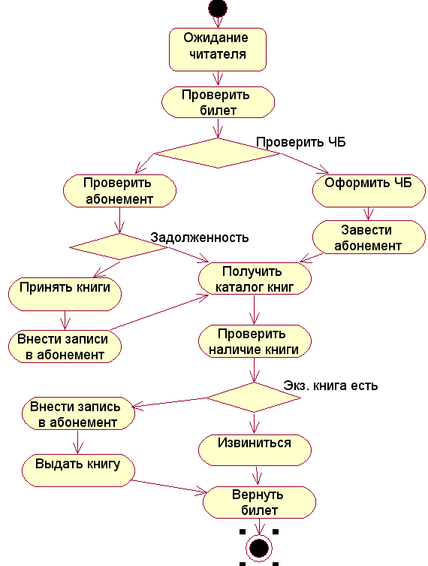
Database design
Example of a description of a domain business model in UML (activity diagram)

Slide 14
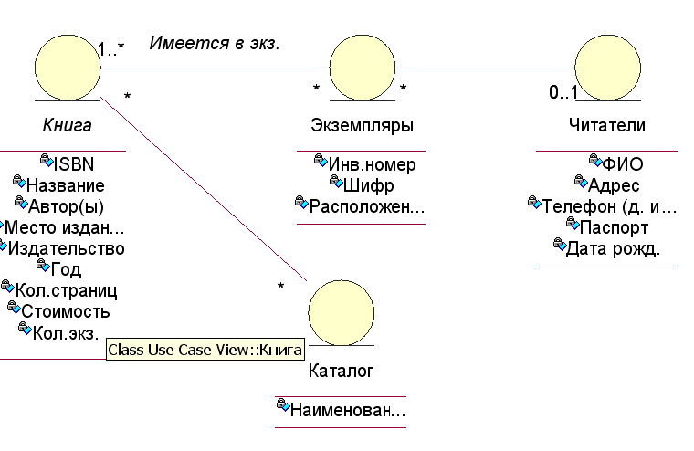
Database design
Example of a description of a domain business model in UML (entity diagram)

Slide 15
Stages of database design
Based on the identified information components of the subject area, an infological model is built, including objects (entities) of the subject area and their attributes, and modeling of the performance of business functions of all participants defined at the stage of developing the requirements specification is performed.
Conceptual design
Datalogical design
A database schema is constructed based on an infological model or identified information attributes of an activity.
Physical design
Definition of database storage structures in the OS and access methods to them and database protection models.The source material for the database design stage is the database schema obtained at the previous stage, and the external memory project of the database server developed at the IC design stage, which holds the structure of the disk device system…

Slide 16
Conceptual design
The result of this design stage is the construction of the primary information structure of the database, which is called the conceptual schema of the database or infological model.
The conceptual schema of the database contains grouped attributes of the subject area according to the signs of functional dependence.
The main purpose of this class of models is to model the feasibility of the functional requirements presented to the IP.
Feature of infological models
Semantic (semantic) content
Independence from a specific DBMS
To describe infological models, there are several types of such models, for example
theHammer-mCleon semantic model
the Shipman functional model
the Chen essential model (ER model)
UML diagrams, etc.

Slide 17
Conceptual design
On the basis of these models, computer-aided design systems are built, so-called. CASE systems.
Based on Chen's model, ERWin, POWER DESIGNER, etc. were created.
RATIONAL ROSE, PARADIGM PLUS, SELECT ENTERPRISE, etc. were created on the basis of the UML model.
Main functions of CASE systems
Create graphical diagrams to describe the subject area
Identify logical errors in the description of diagrams
Create project documentation and drawings
Generate programs to create structures for a specific tool environment

Slide 18
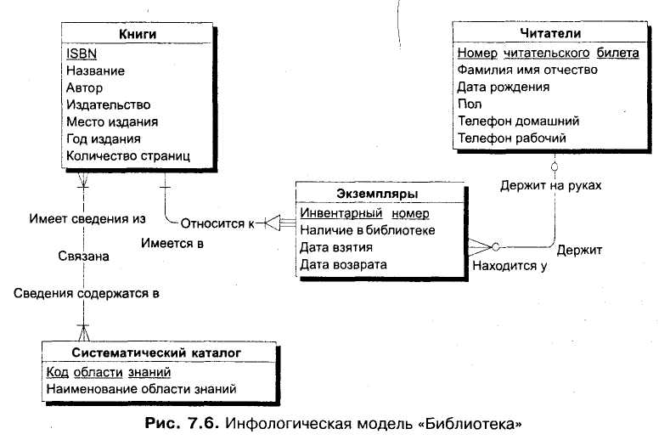
Conceptual design
Example of an ER data model of the IC "library" in IE (POWER DESIGNER) notation
mandatory communication
optional link

Slide 19
Conceptual design
An example of an ER data model of the IC "library" in IDEF1X (Erwin) notation

Slide 20
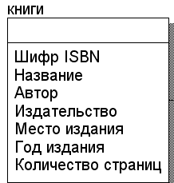
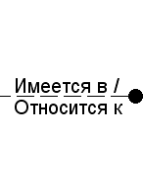
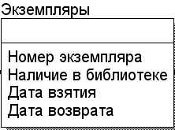
Conceptual design
Description of the ER data model in IDEF1X notation (Erwin)
The ER model consists of
Entities - an abstraction of a certain set of objects in the real world that have the same characteristics, rules and behaviors (a rectangle indicating the name in the form of a noun)
Attributes - an abstraction of a characteristic possessed by all possible instances of an entity(inside the entity to which it belongs, with the indication of the name in the form of a noun)
Connections are an abstraction of some relationships that systematically arise between different types of objects in the real world(a line connecting two entities with an indication of the relationship in the form of an action verb)

Slide 21
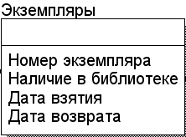
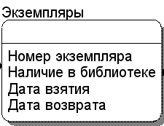
Conceptual design
Description of the ER data model in IDEF1X notation (Erwin)
The ER model consists of
Entities can be of 2 types:
Independent entity Instances of an independent entity can be uniquely identified without defining its relationships with other entities;
A dependent entity, on the contrary, cannot be uniquely identified without defining its relationships with other entities.

Slide 22
Conceptual design
Description of the ER data model in IDEF1X notation (Erwin)
The ER model consists of
Connections can be of 2 types
identifying
A relationship is called identifying if an instance of a child entity is identified through its relationship with the parent entity.
non-identifying
A relationship is called non-identifying if an instance of a child entity is identified not through a relationship with the parent entity.
For an identifying relationship, the attributes that make up the primary key of the parent entity will be included in the primary key of the child entity. A child entity with an identifying relationship is always dependent. For a non-identifying relationship, the attributes that make up the primary key of the parent entity will be part of the non-key attributes of the child entity.

Slide 23
Conceptual design
Description of the ER data model in IDEF1X notation (Erwin)
Displaying elements of the ER model
Connections can display power
The link power is the ratio of the number of instances of the parent entity to the corresponding number of instances of the child entity.
1:1
1:М
М:М
The validity of empty (NULL) values in non-identifying relationships is represented by ERwin as an empty diamond on the arc of the relationship from the side of the parent entity.
1:М

Slide 24
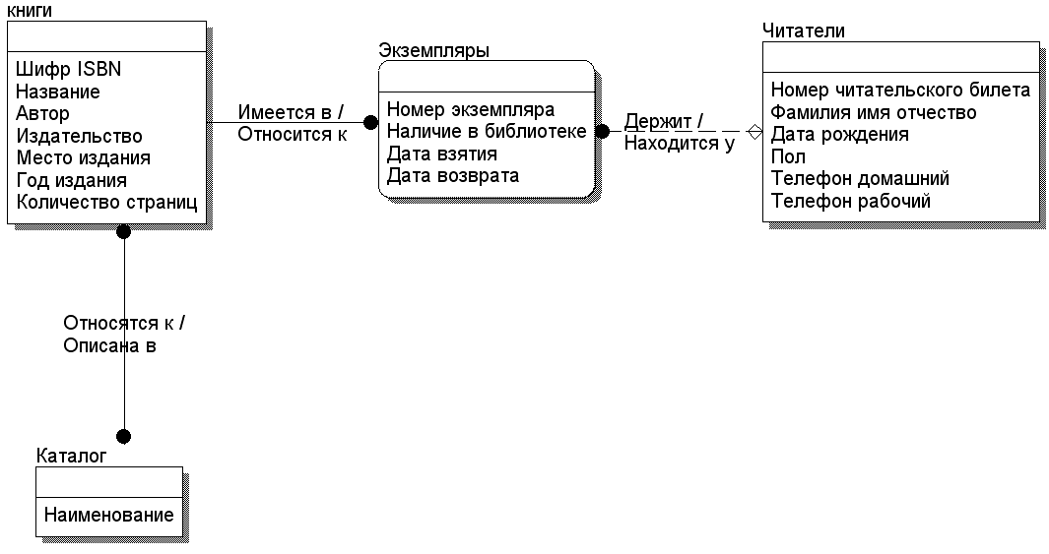
Conceptual design
An example of an ER data model of the IC "library" in IDEF1X (Erwin) notation
One copy can be held by one reader
One reader can hold multiple instances
The books are available in many copies
One copy refers to one book
Books belong to many catalog titles
One name of the catalog is described in many books

Slide 25
Conceptual design
There are 2 approaches to the implementation of this design stage
- the functional approach (bottom-up or bottom-up design)
implements the principle of "from the task" - defining attributes that are grouped into initial relationships based on analysis.
- subject approach (top-down or top-down (top-down design))
implements the principle of "from the problem" - the definition of objects (or entities) of the subject area, the relationships between them and the identification of attributes of objects.

Slide 26
Conceptual design
An example of a functional approach to designing a trading company's IS database
Attribute groups identified:
the group that characterizes the order,
the group that characterizes the arrival of goods
Order date
Order number
Organization
Customer
Customer's address, tel
Full name of the contact person position
Position, full name of the employee
Product name
Product Specification
Quantity
Price
The amount
Total amount
Product Name
Product Specification
Supplier organization
Supplier address, tel.
Position, full name of the contact person
Date of delivery
Invoice number
Quantity of arrival
Price
Amount

Slide 27
Conceptual design
An example of a subject-based approach to designing a trading company's IS database
Objects, their attributes and relations are revealed:

Slide 28
Datalogical design
The main goal of the stage is to develop a database schema.
A database schema is a set of interrelated relationships in which all attributes, their types and integrity constraints are defined, primary and secondary keys are set, indexes are defined.
Creating a database schema is performed in 2 stages.
Stage 1. Synthesis stage
Creating initial relationships based on the results of the previous stage
Stage 2. Decomposition stage.
Replacing the original relationships with another set of relationships in order to obtain a correct database schema
The correct database schema is a scheme in which there are no unwanted dependencies between the attributes of the relationship.

Slide 29
Synthesis stage
The synthesis stage is the process of creating initial relationship schemes.
When using the functional approach, it is
transferring the grouped attributes to the corresponding table,
determining the primary keys in the tables,
determining the general attributes by which links are established.
When using the subject approach, this is
replacing objects (entities) with tables,
defining primary keys in tables,
replacing many-to-many relationships with intermediate tables, which include the primary attributes of the tables being joined

Slide 30
Synthesis stage
An example of a subject-based approach to designing a trading company's IS database

Slide 31
The decomposition stage
The decomposition stage is a process of sequential normalization of relationship schemes
Each normalization stage has its own normal form
Each normal form has the following properties
When moving to the next normal form, the properties of the previous normal forms are preserved.
Each subsequent normal form improves in some sense the properties of the previous one
The equivalence of the DB schema is preserved when moving to the next normal form.
A database schema is called equivalent if the content of the original database schema can be obtained by naturally connecting the relationships included in the resulting schema, and the number of tuples in the original schema remains unchanged.

Slide 32
Decomposition stage
In the theory of relational databases, the following sequence of normal forms (NF) has been developed:
first normal form (1NF)
second normal form (2NF)
third normal form (3NF)
Boyes-Codd normal form (BKNF)
fourth normal form (4NF)
fifth normal form (5NF)
Equivalent transformations in normal forms are based on the analysis of functional dependencies between the attributes of the relation
The functional dependence of the set of attributes B on the set of attributes A of the relation R or
the ratio of projections R[A] and R[B] is called such that at each moment of time only one element of projections R[A] corresponds to any element of projections R[B], which is included with it in any tuple of the relation R

Slide 33
Decomposition stage
Let there be the following relation R with the data set
Let's define the functional dependencies A ->B and B ->A.
If each value from A corresponds to a single value from B, then A ->B, if not, then A ->B.
A | B | C | D
a₁ | b₁ | c₁ | d₁
a₂ | b₂ | c₁ | d₁
a₁ | b₁ | c₂ | d₂
a₃ | b₁ | c₂ | d₃
a₂ | b₂ | c₃ | d₂
a₁ | b₁ | c₃ | d₄
a₄ | b₃ | c₄ | d₂
Functional dependencies are determined not on the current state of the database, but on its various states.
Functional dependencies are determined based on a deep analysis of the subject area.

Slide 34
Decomposition stage
Let there be the following relation
R (Name, Date of Birth, Zodiac Sign)
Let's determine the functional dependencies of the Zodiac Sign on the Date of birth
Solution
(Date of Birth) –>(Zodiac Sign)
Functional dependencies are determined based on a deep analysis of the subject area.
Zodiac sign is determined by month and birthday!

Slide 35
Decomposition stage 1NF
A relation is in 1NF if and only if there are only elementary attribute values at the intersection of each column and each row.
Signs of finding a relation in 1NF
All fields are atomic
There are no repeating groups
Primary key is defined
All attributes depend on the primary key

Slide 36
Decomposition stage 2NF
A relation is in 2NF if and only if it is in 1NF and does not contain incomplete functional dependencies of non-primary attributes on attributes of the primary key.
Full functional dependency is when the value in each non-key column is uniquely determined by the value of all columns of the primary key
Example. Relation to simulating the delivery of a session with the following attributes
R(FULL NAME; Nom.WK; Group; Discipline; Assessment)
PK
PK
To bring the relation to 2NF, it should be divided into projections: move non-key attributes, between which there is an incomplete relationship, to another relation

Slide 37
Decomposition stage 2NF
Example. Relation to simulating the delivery of a session with the following attributes
R(Full name; order number; group; disciplines; evaluation)
PK
PK
R₂ (Full name; order number; group)
R₂(order number; disciplines; evaluation)
PK
FK
PK

Slide 38
Decomposition stage 3NF
A relation is in 3NF if and only if it is in 2NF and does not contain transitive dependencies (no non-key attribute depends on another non-key attribute, but depends only on the primary key).
A functional dependency A->B is called transitive if there exists a set of attributes C such that C is not a subset of A and does not include B , ,
there are dependencies and and
there is no dependency

Slide 39
Decomposition stage 3NF
Example. Let there be a relation R
R(Full name; order number; group; specialization)
PK
To bring the relation to 3NF, it should be divided into projections: move non-key attributes, between which there is a dependency, to another relation

Slide 40
Decomposition stage BKNF
A relation is in BKNF if and only if it is in 3NF and each determinant of the relation is a possible key of the relation
The determinant of naz. any attribute whose value depends on the values of other attributes
Conditions when the relation is in 3NF, but is not in BKNF:
1. The relation has 2 or more potential keys;
2. Potential keys are composite.
3. Potential keys overlap, i.e. they have at least one common attribute.

Slide 41
Decomposition stage BKNF
Example. Let there be a relation R that simulates the passing of an examination session with the following conditions:
you can take the exam in one subject several times
- a unique number is used to identify the student
R(ID; Order nom; Discipline; Date; Assessment)
PK
PK
PK
Potential keys:
Functional dependencies
Order Number+ Discipline + Date
ID+ Discipline + Date
Determinants that are not potential keys

Slide 42
Decomposition stage 4NF
A relation is in 4NF if and only if it is in BKNF and if, in the case of the existence of a multivalued dependency A->>B, all other attributes are functionally dependent on A (i.e., if there is a multivalued dependency, then only one attribute)
With respect to R(A,B,C), there is a multivalued dependence of B on A (A->>B) if and only if the set of values of B corresponding to a pair of values of A and C depends only on A and does not depend on C
Feijin's theorem: The relation R(A,B,C) can be projected losslessly into the relations R1(A,B) and R2(A,C) if and only if there is a multivalued dependence A->>B and A->>C
R( Order nom; Discipline; Group)
PK
R₁(Order nom; Group)
R₂(Group; Discipline)
PK
PK
Order nom | Group
20-01 | 20
20-02 | 20
20-03 | 20
21-01 | 21
Group | Discipline
20 | АОС
20 | АВМ
20 | ОПБД
21 | АВМ

Slide 43
Decomposition stage
Example of normalization of a trading company's IS database tables
Duplicate attribute group

Slide 44
Decomposition stage
Example of normalization of a trading company's IS database tables
Transitive dependencies:
Order code -> Company-> City
Order code -> Company-> Address
Order code -> Employee's full name -> Employee's position

Slide 45
Decomposition stage
Example of normalization of a trading company's IS database tables
Full functional dependencies:
(Order Code, Product Name, Product Specification --> Quantity, Amount )
Incomplete functional dependencies:
Product Name, Product Specification ->Price
(Order Code-/-> Price)

Slide 46
Decomposition stage
Example of normalization of a trading company's IS database tables
Transitive dependencies:
Product Name, Product Specification -> Organization-> City

Slide 47
Decomposition stage
Example of normalization of a trading company's IS database tables
Transitive dependencies:

Slide 48
Decomposition stage
The final database schema after the normalization stage

